Slide 1
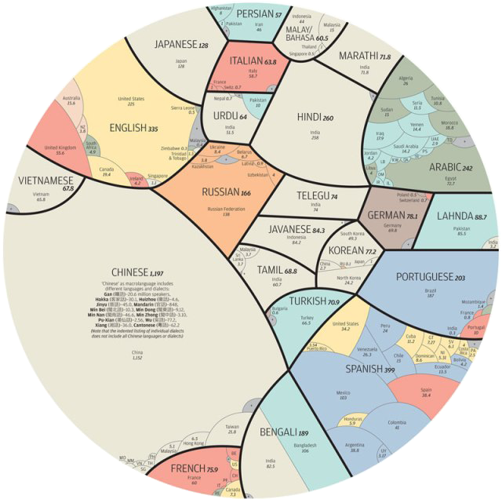
Чому багато в світі мов?

Slide 2






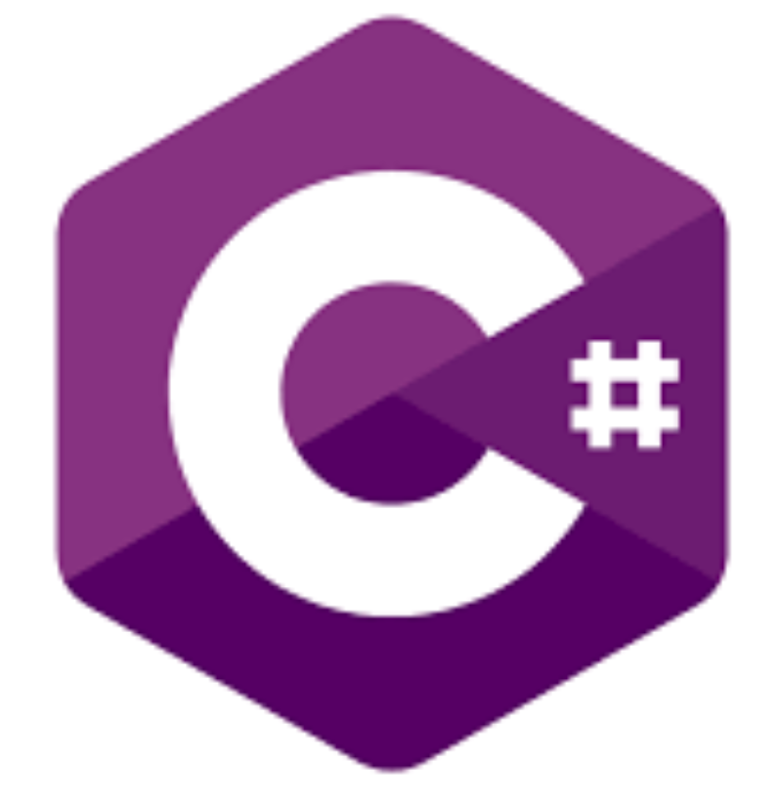





Development: Programming languages

Slide 3
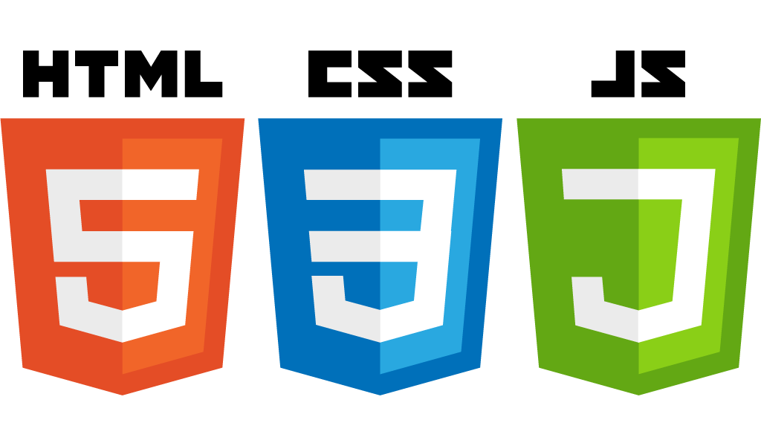

Slide 4

Dynamic typed
Prototype-based
Object-oriented
Single-threaded

Slide 5
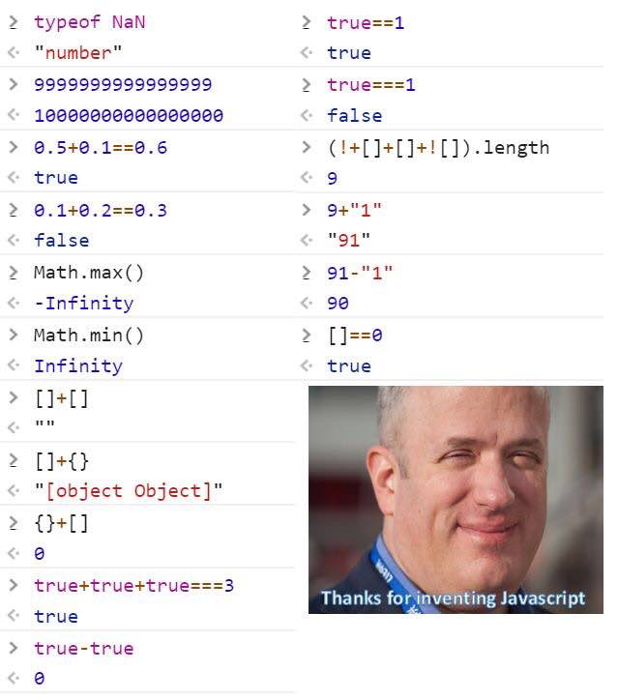

Slide 6
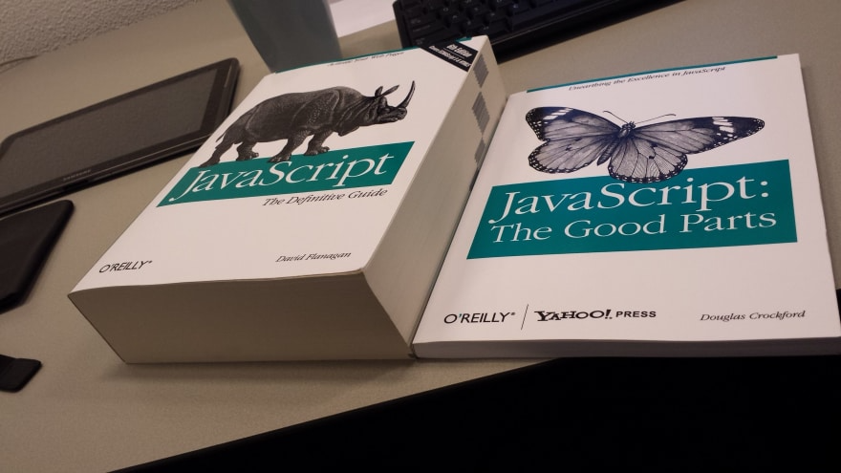

Slide 7
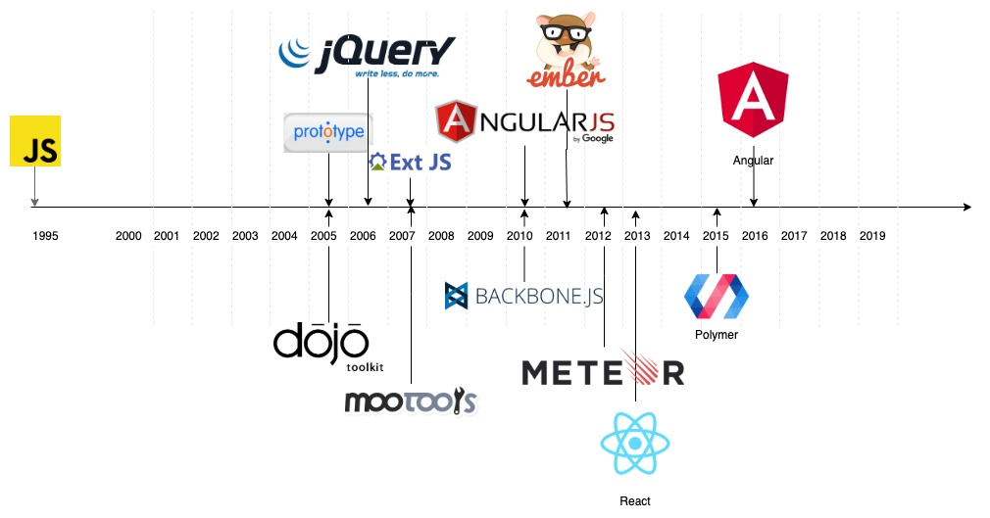



Slide 8

Asynchronous JavaScript + XML

Slide 9
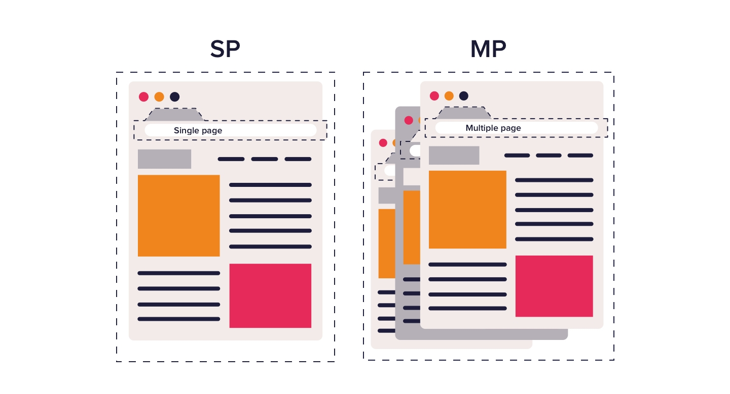

Slide 10
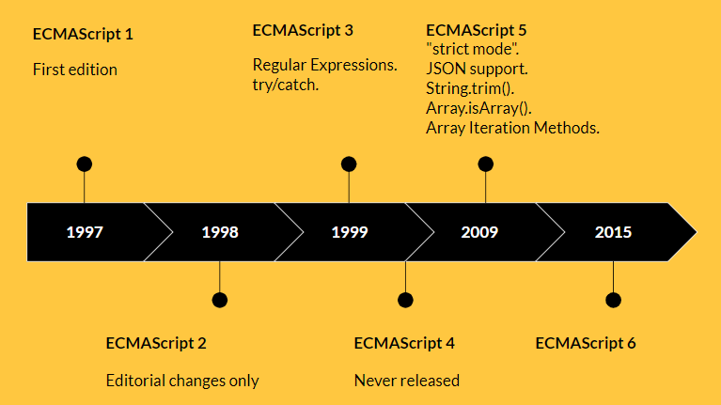

Slide 11

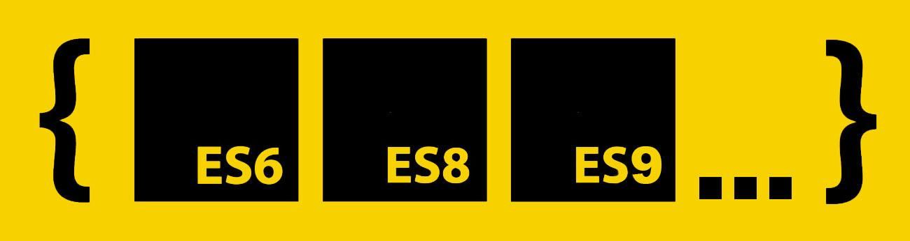
ES2016
ES2017
ES2018
ES2019
ES2020

Slide 12
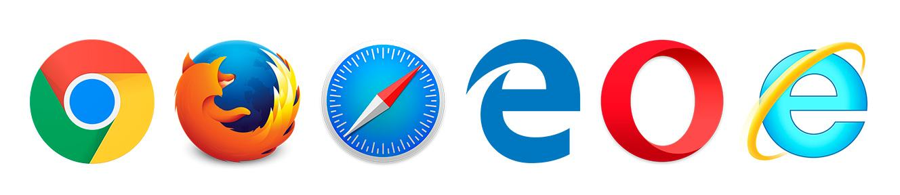

Browsers
Gecko/
SpiderMonkey
WebKit/
JavaScriptCore
Chakra
Chakra
A JavaScript engine is a computer program that executes JavaScript (JS) code.

Slide 13

Javascript environments
Browsers
Nodejs platform

Slide 14


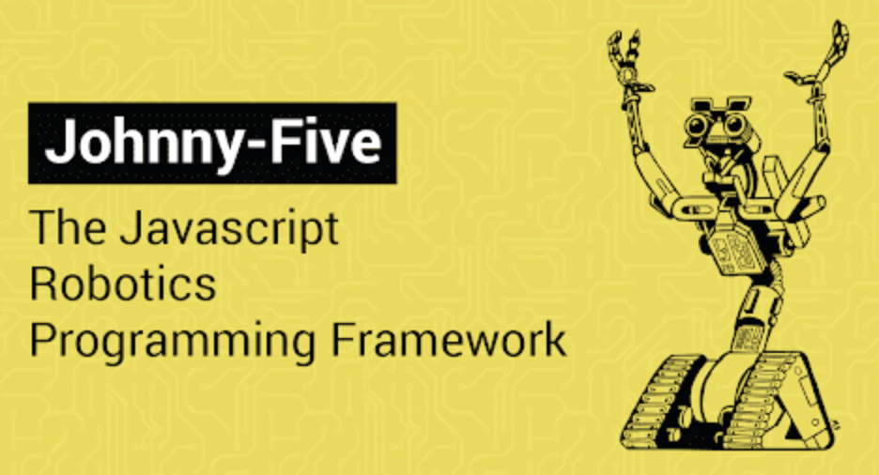

Internet of things (iot)

Slide 15
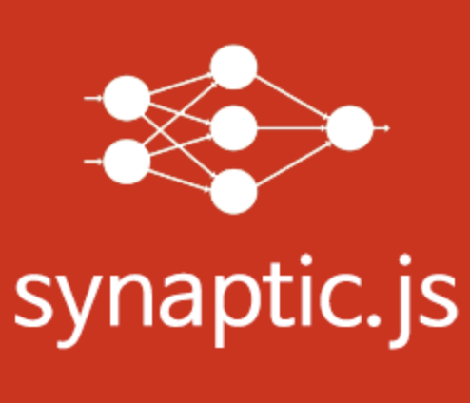

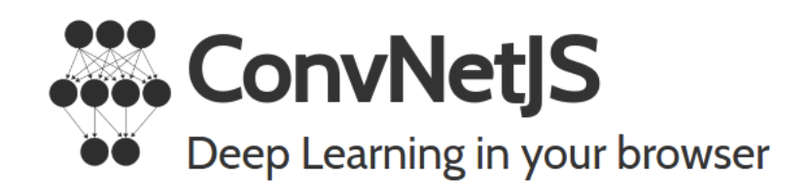
Machine learning

Slide 16
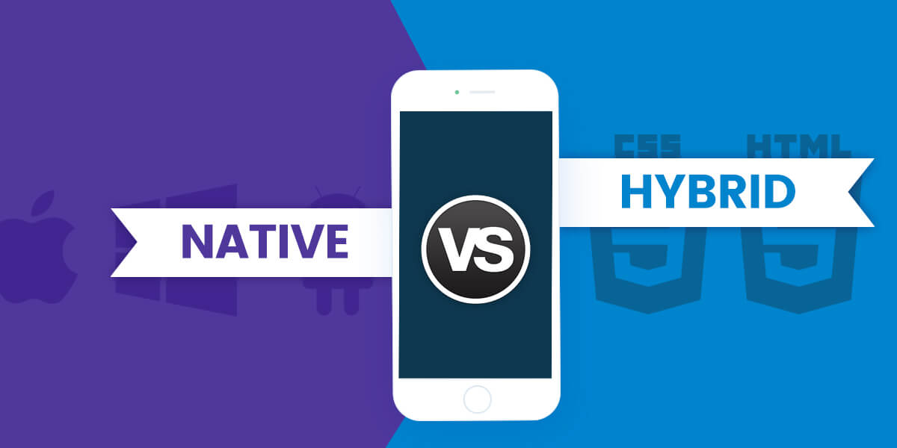

Slide 17
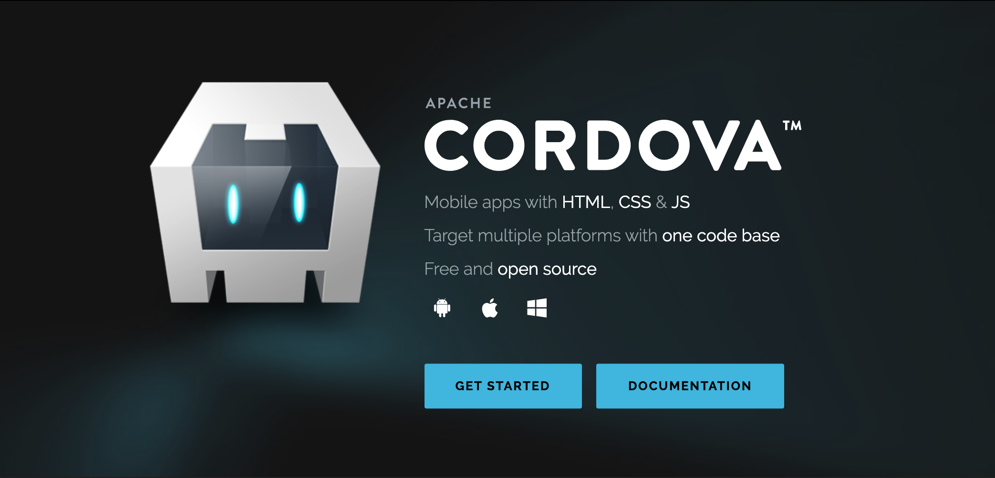

Slide 18
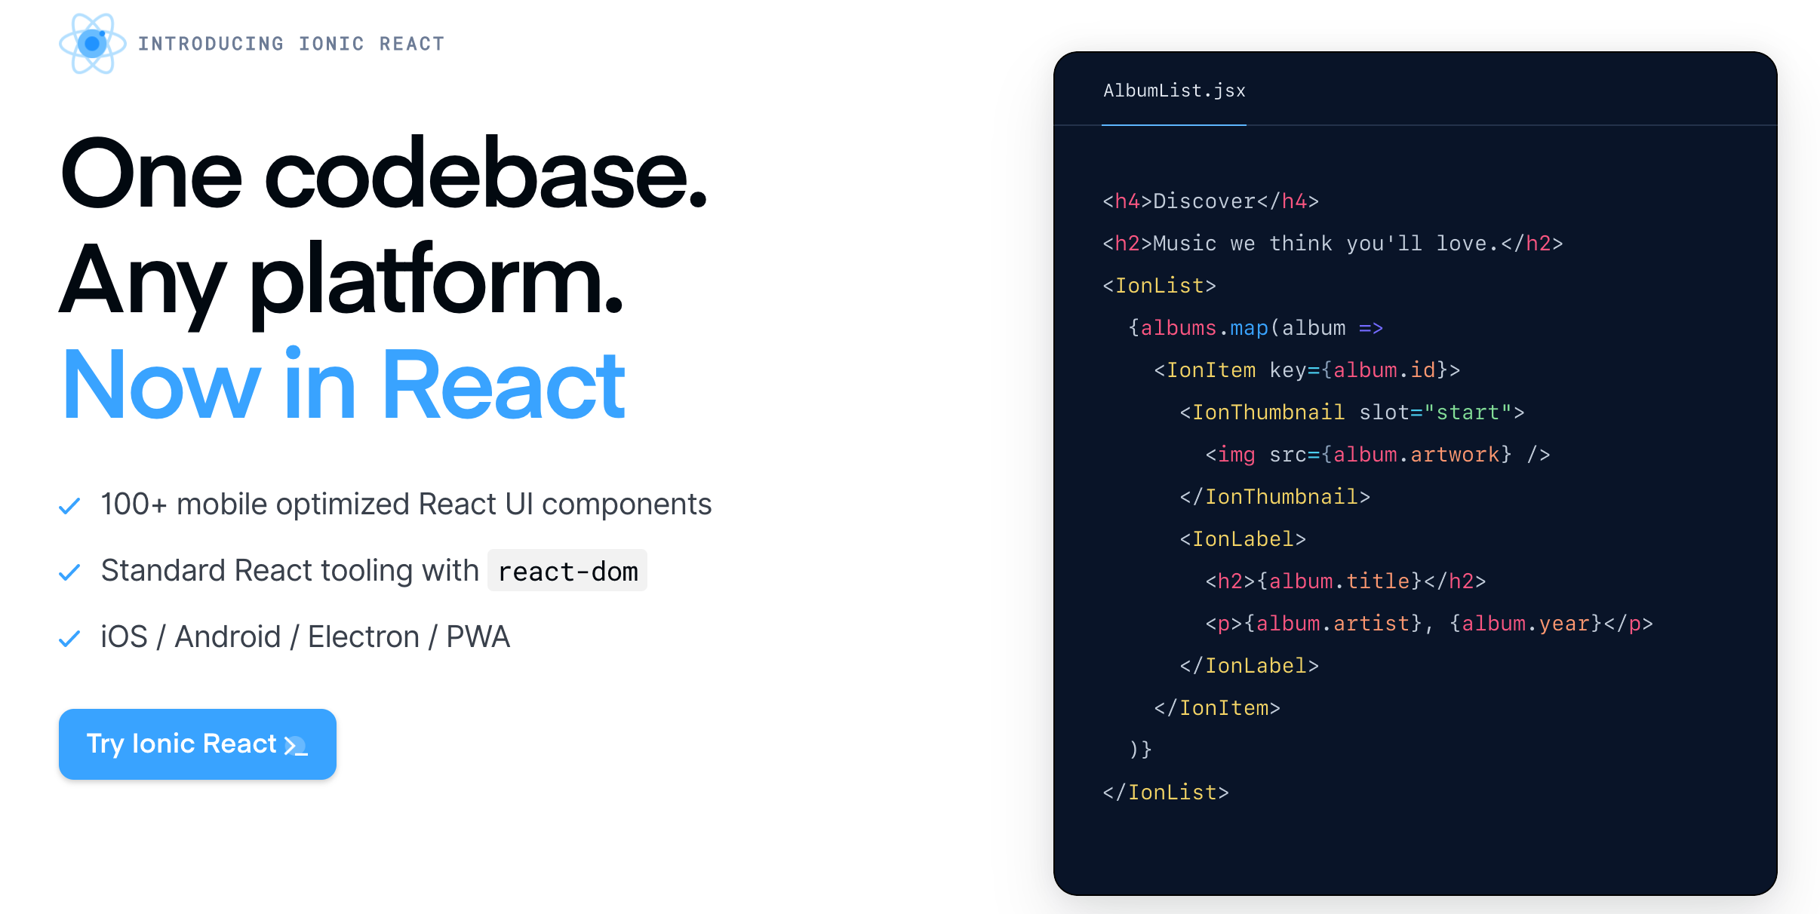

Slide 19
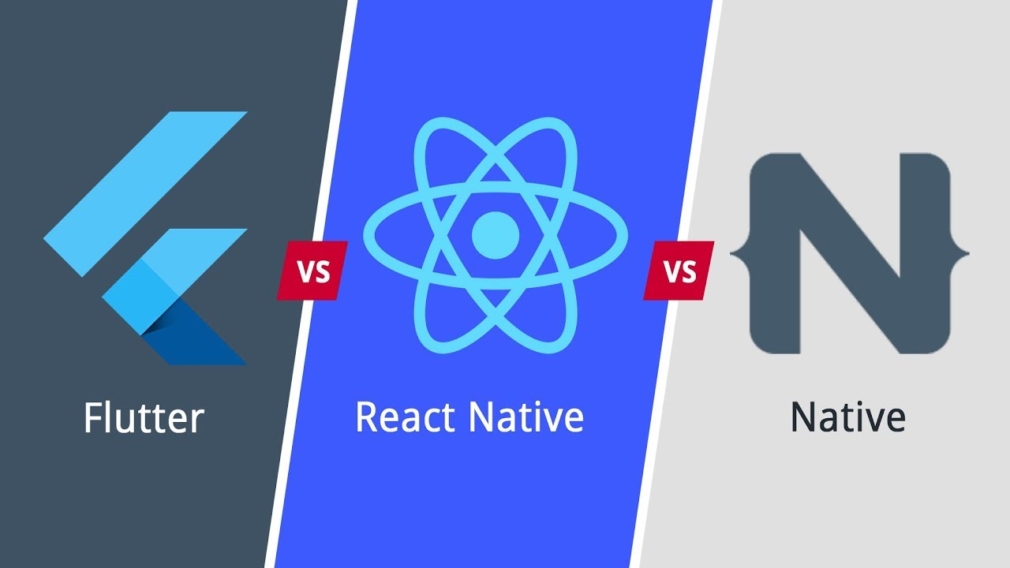

Slide 20


Slide 21
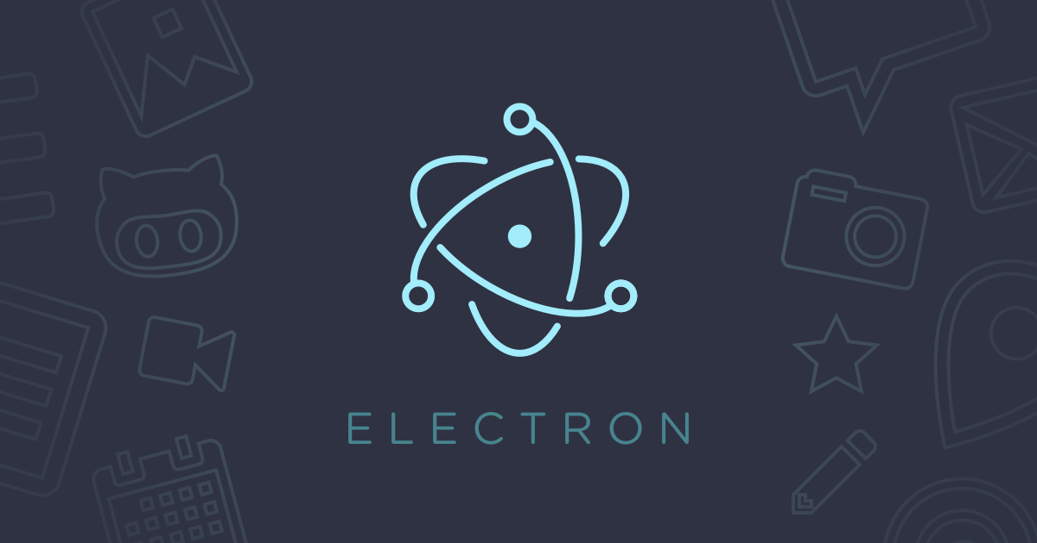

Slide 22








Slide 23
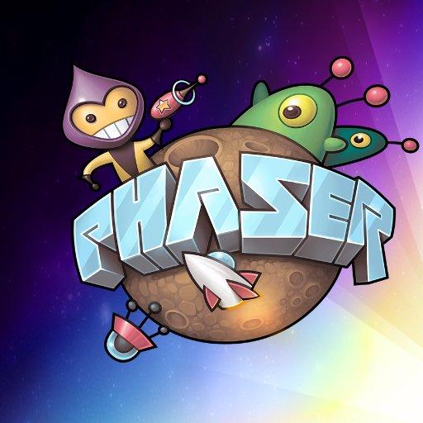



Slide 24
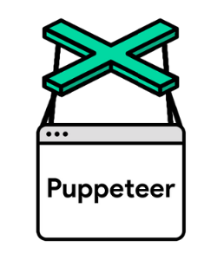

JavaScript end to end testing

